Slide 1
MTBF 操作方式(使用 Power BI)

Slide 2
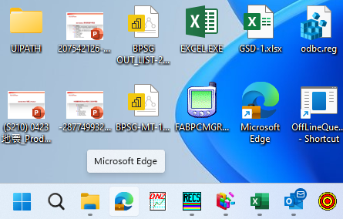
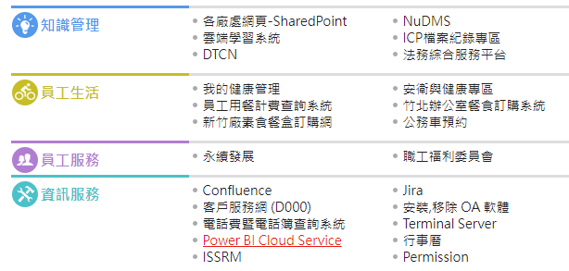
開啟網頁
1
按 Power BI Service
2

Slide 3
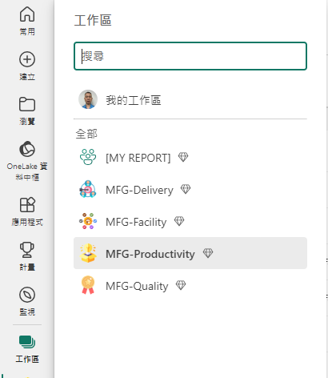
2
按 MFG-Productivity
1
點選工作區

Slide 4
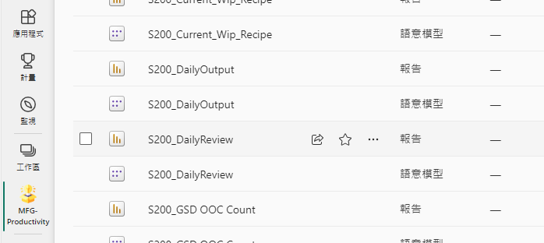
點選 S200_DailyReview 報告

Slide 5
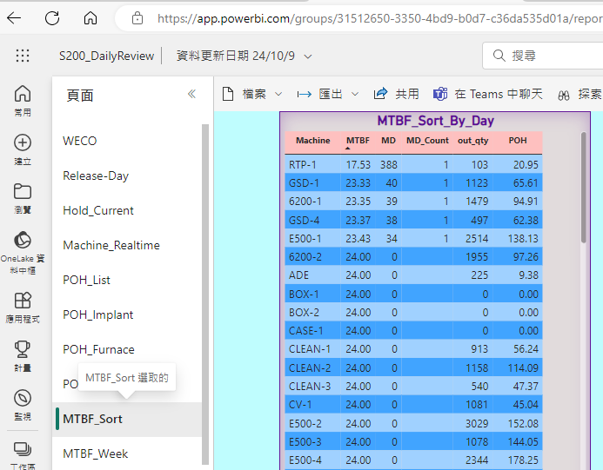
2
擷取 MTBF_Sort_By_Day 前五名
1
點選 MTBF_Sort

Slide 6
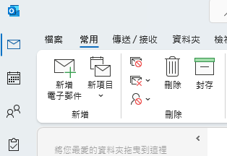
開啟 Outlook
新增電子郵件

Slide 7
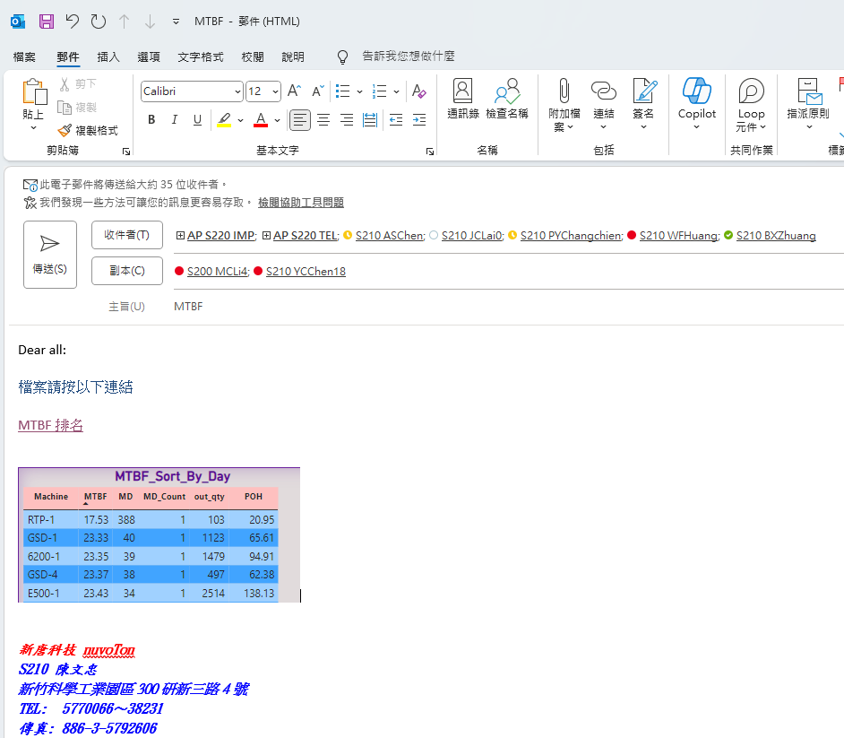
將擷取 MTBF_Sort_By_Day 前五名
鍵入收件者/主旨/檔案連結/貼上擷取圖片

Slide 8
按傳送即完成

Slide 9
MTBF 操作方式(Excel)

Slide 10
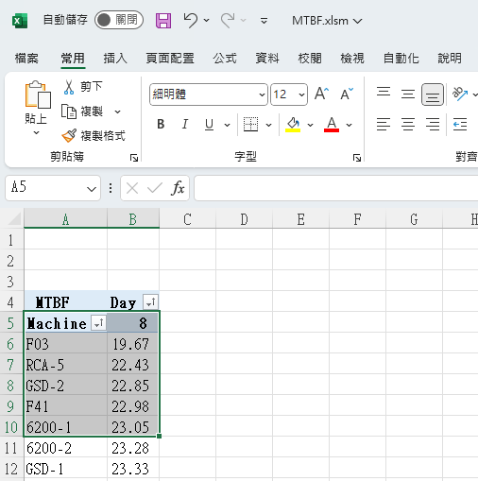
開啟 Excel
1
2
點選資料

Slide 11
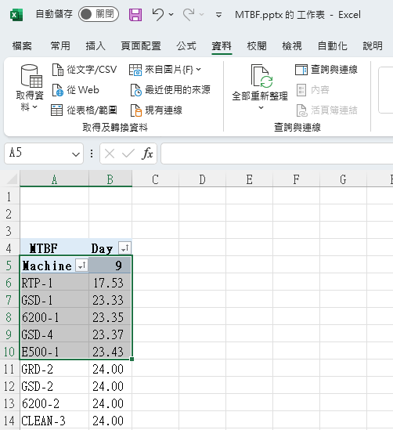
1
點選全部重新整
2
確認日期
3
複製前五筆資料

Slide 12
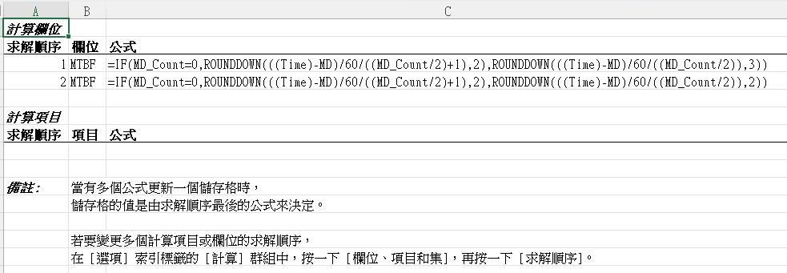
MTBF 計算公式
MTBF ( Mean Time Between Failures ) , 代表平均故障間隔時間。

Slide 13
開啟 Outlook
新增電子郵件

Slide 14
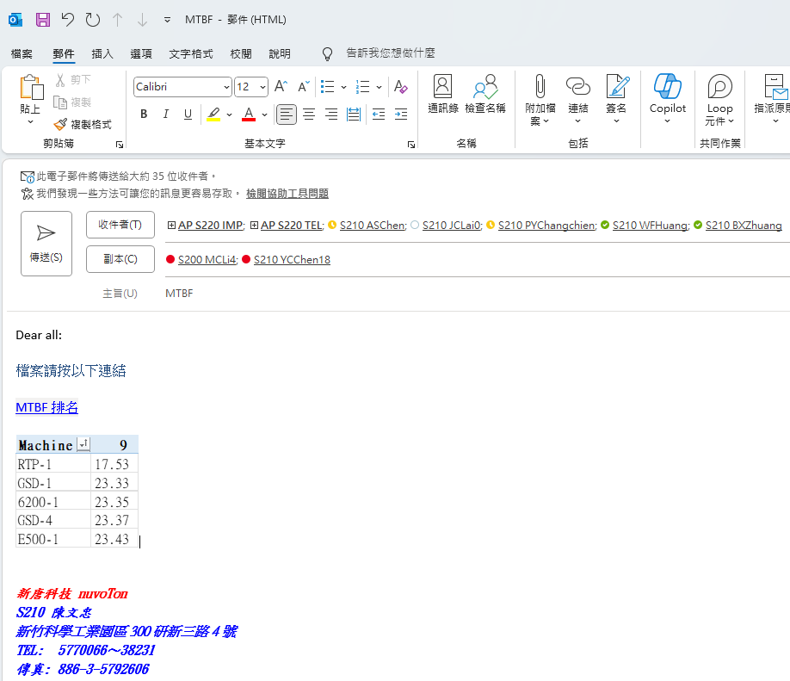
將擷取 MTBF Machine 前五名
鍵入收件者/主旨/檔案連結/貼上擷取圖片

Slide 15
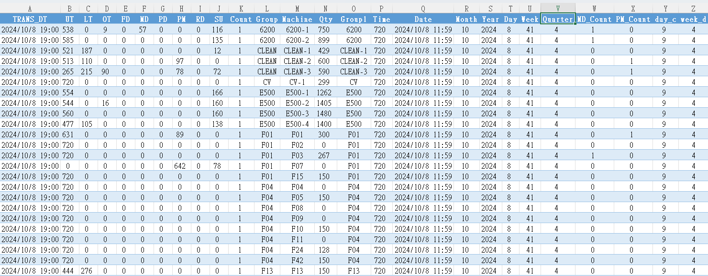

Slide 16
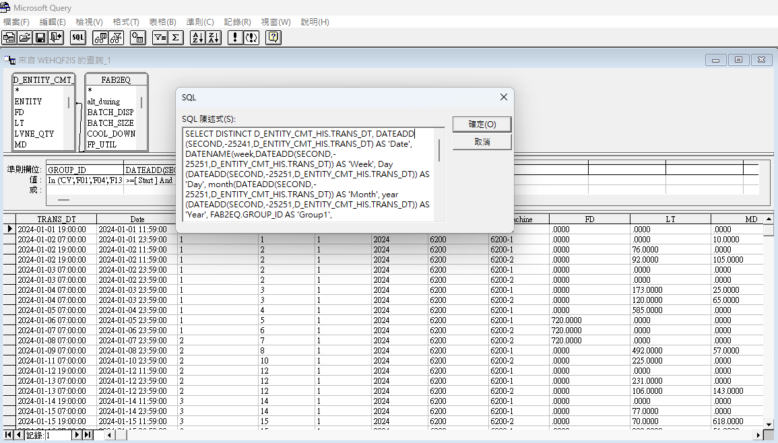
Excel
Excel 檔案透過 Microsoft Query 取得

Slide 17
以下為 SQL 設定
SELECT DISTINCT D_ENTITY_CMT_HIS.TRANS_DT, DATEADD(SECOND,-25241,D_ENTITY_CMT_HIS.TRANS_DT) AS 'Date', DATENAME(week,DATEADD(SECOND,-25251,D_ENTITY_CMT_HIS.TRANS_DT)) AS 'Week', Day(DATEADD(SECOND,-25251,D_ENTITY_CMT_HIS.TRANS_DT)) AS 'Day', month(DATEADD(SECOND,-25251,D_ENTITY_CMT_HIS.TRANS_DT)) AS 'Month', year(DATEADD(SECOND,-25251,D_ENTITY_CMT_HIS.TRANS_DT)) AS 'Year', FAB2EQ.GROUP_ID AS 'Group1', D_ENTITY_CMT_HIS.ENTITY AS 'Machine', D_ENTITY_CMT_HIS.FD, D_ENTITY_CMT_HIS.LT, D_ENTITY_CMT_HIS.MD, D_ENTITY_CMT_HIS.OT, D_ENTITY_CMT_HIS.out_qty AS 'Qty', D_ENTITY_CMT_HIS.PD, D_ENTITY_CMT_HIS.PM, D_ENTITY_CMT_HIS.RD, D_ENTITY_CMT_HIS.SU, D_ENTITY_CMT_HIS.UT, 1 AS 'Count', 720 AS 'Time', ((MONTH(DATEADD(SECOND,-25241,D_ENTITY_CMT_HIS.TRANS_DT))-1)/3)+1 AS 'Quarter'
FROM WEHQF2IS.dbo.D_ENTITY_CMT_HIS D_ENTITY_CMT_HIS, WEHQF2IS.dbo.FAB2EQ FAB2EQ
WHERE D_ENTITY_CMT_HIS.ENTITY = FAB2EQ.MIS_ID AND ((FAB2EQ.GROUP_ID In ('CV','F01','F04','F13','F17','F20','F23','F27','F28','F31','F33','F35','F36','GRD','HFV','LM','LP-N','LP-N2','LP-P','LP-T','LP-T9','OVEN6200','OVEN-GSD','RCA','E500','RTP','WSIX','6200','GSD','CLEAN-3','CLEAN-2','CLEAN-1')) AND (DATEADD(SECOND,-25241,D_ENTITY_CMT_HIS.TRANS_DT)>=? And DATEADD(SECOND,-25241,D_ENTITY_CMT_HIS.TRANS_DT)<=?))
ORDER BY FAB2EQ.GROUP_ID

Slide 18
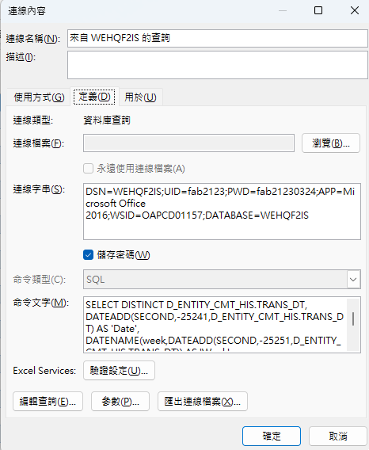
換資料庫時須修改資料庫設定

Slide 19
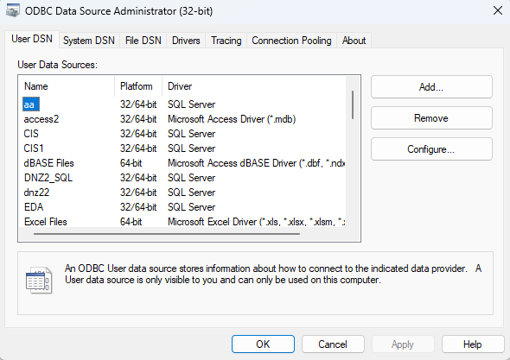
DSN=WEHQF2IS;UID=fab2123;PWD=fab21230324;APP=Microsoft Office 2016;WSID=OAPCD01157;DATABASE=WEHQF2IS
Name:WEHQF2IS => Name: ???
Server:WEHQDBMS01 => Server: ???
Login ID:fab2123 => Login ID: ???
Password:fab21230324 => Password: ???

Slide 20
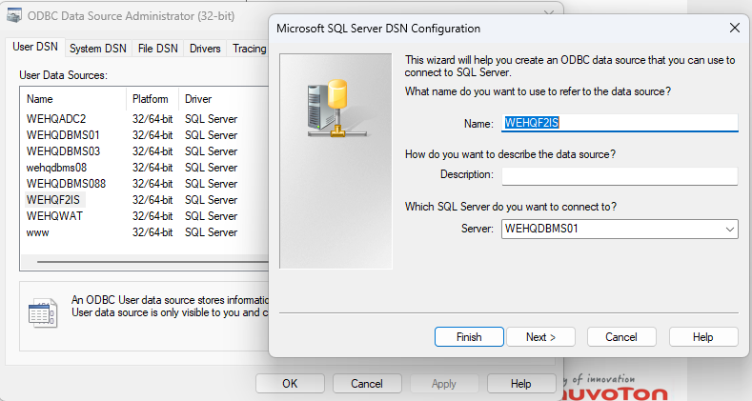
Name:WEHQF2IS/Server:WEHQDBMS01

Slide 21
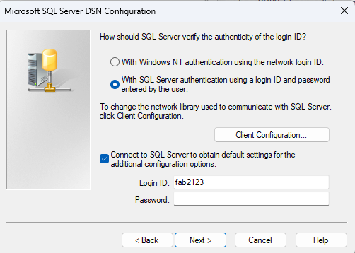
Login ID:fab2123/Password:fab21230324

Slide 22
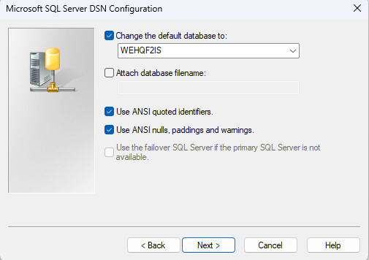
WEHQF2IS

